Slide 1
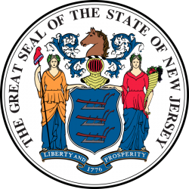
Quarterly Update
January 30, 2024
www.revnj.org

Slide 2
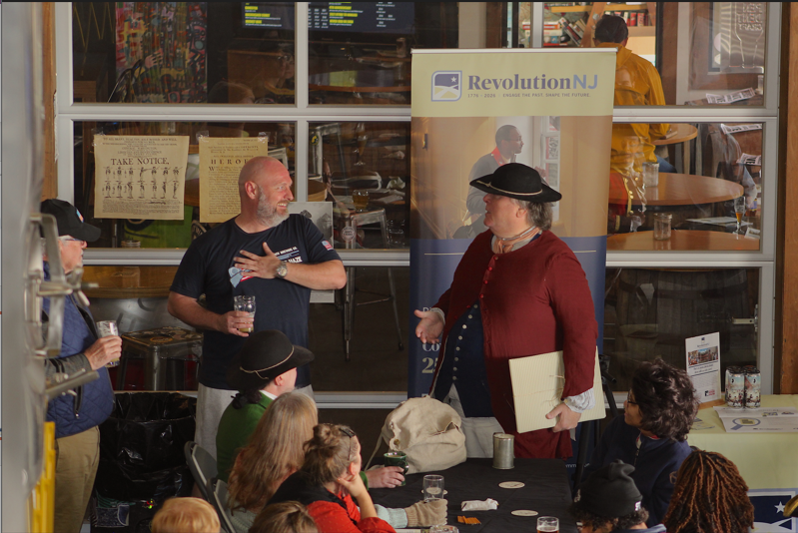
Today’s Agenda
In the News
Resources and Opportunities
Around the Field
Guest Speakers
Jeff Vasser
Ted Maturo
Q and A
Pictured: Mike Jones (Owner of Hackensack Brewery) and Todd Braisted (Historian and RevolutionNJ Advisory Council Member) at our first Tavern Talks

Slide 3
In the News

Slide 4
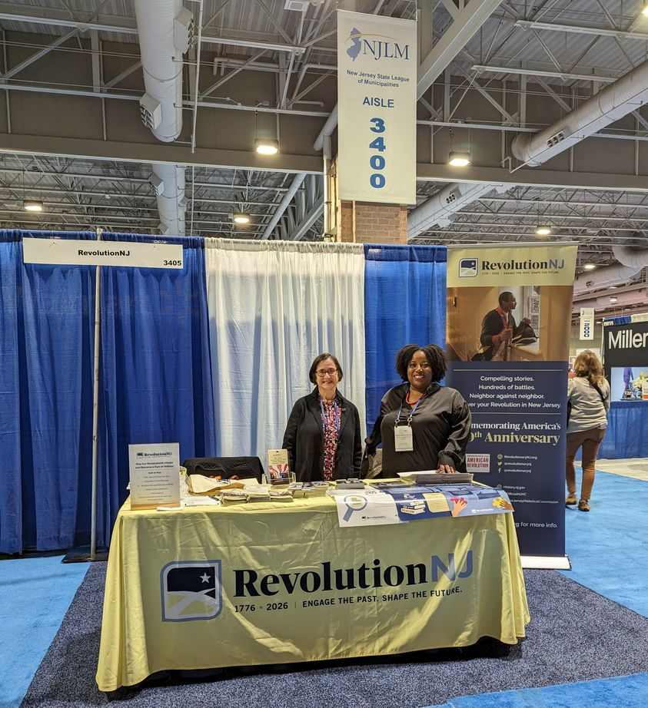
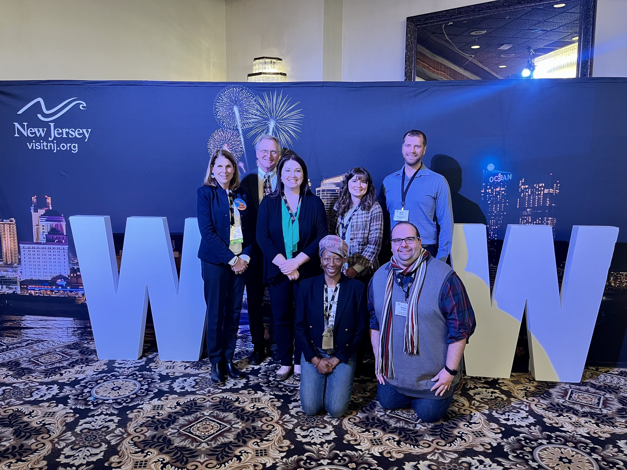
RevolutionNJ in the Field
NJ League of Municipalities Conference
NJ Tourism Industry Association Conference

Slide 5
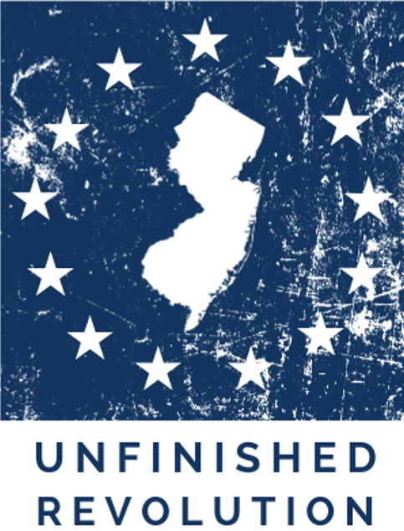
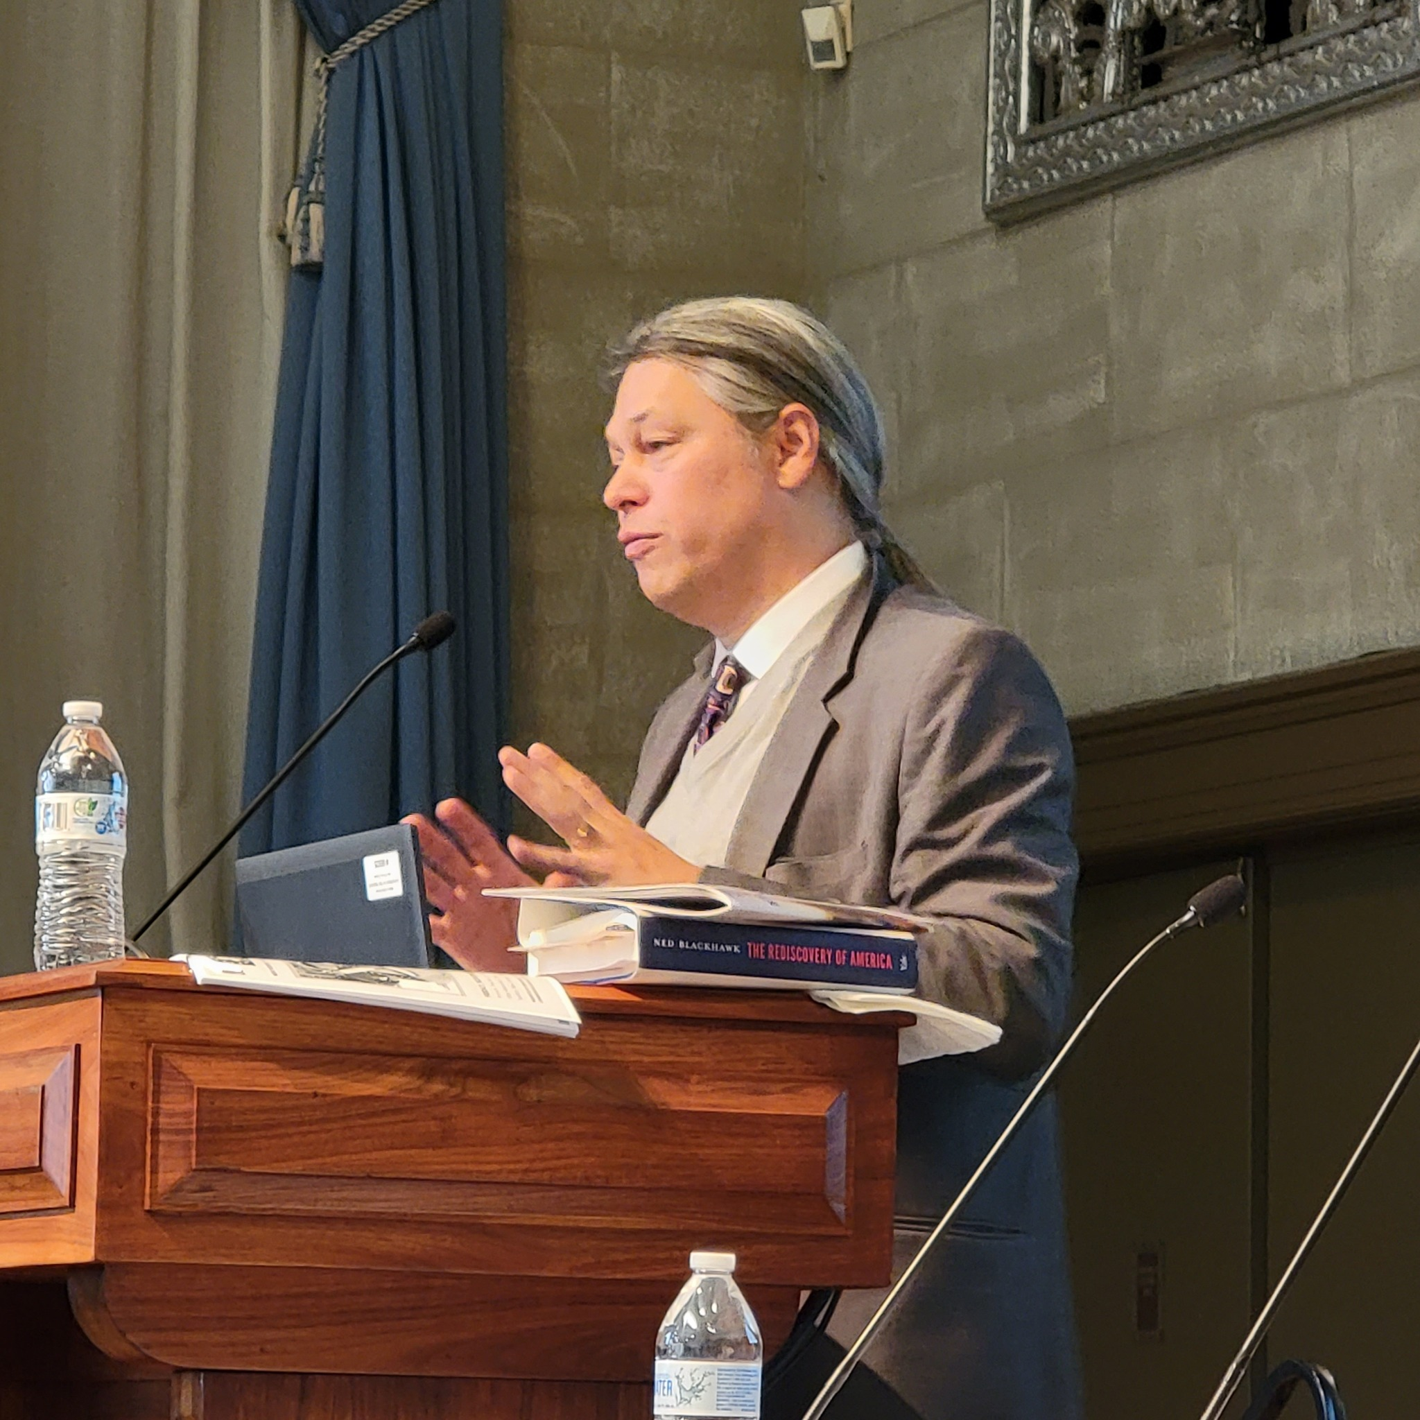
Unfinished Revolution Conference
The annual New Jersey Historical Commission Conference was held on November 17, 2023 and its theme was Unfinished Revolution: New Perspectives on the American Revolution in New Jersey
For a list of presenters, please visit:
https://www.njhistoryconference.org
Pictured: Keynote Speaker Ned Blackhawk at the Unfinished Revolution Conference

Slide 6
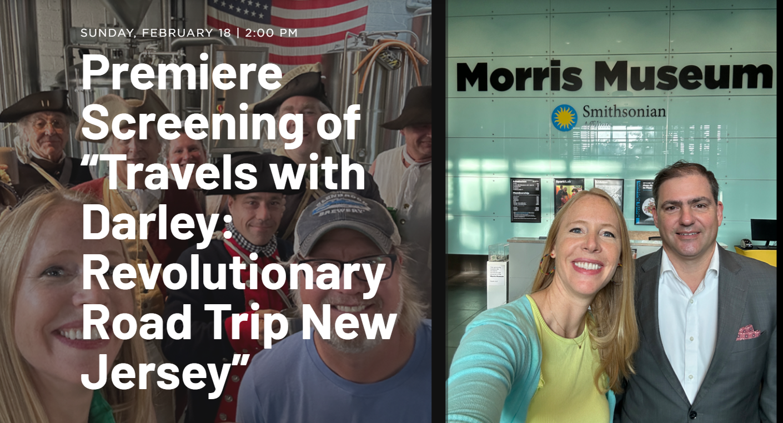
Travels with Darley: Revolutionary Road Trip
Carrie Fellows, Executive Director of Crossroads of the American Revolution joined Darley Newman, Smithsonian Associates, and an all-star panel to discuss heritage tourism and Revolutionary War history in New Jersey.
Morris Museum Premiere Screening 2/18/24 at 2pm:
https://morrismuseum.org/learn/public-programs/premiere-screening-of-travels-with-darley-revolutionary-road-trip-new-jersey
For a preview of the new season, visit:
https://www.youtube.com/watch?v=a3ngAmHOwls

Slide 7
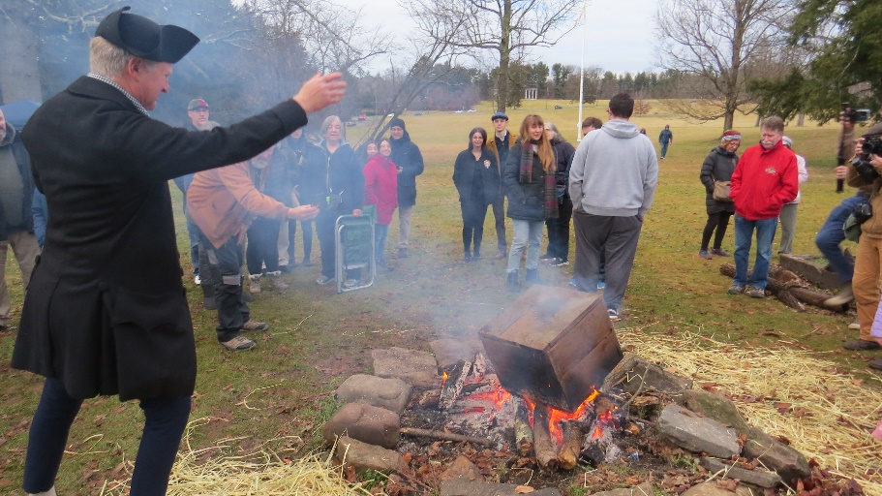
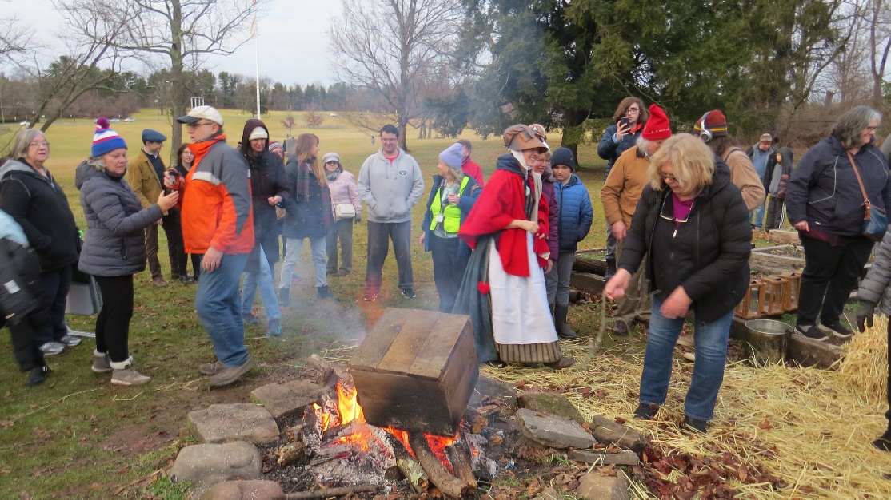
New Jersey Joins the Revolution!
Did you know that, just a month after the famous Tea Party in Boston, New Jersey was the next colony to openly support Massachusetts?
In January, 1774, students in Princeton broke into the school stores, collected all the tea, and burnt it in front of Nassau Hall.
This moment was commemorated this past weekend at Princeton Battlefield, 250 years from the month that it first happened.
And so the 250th is underway, and New Jersey is leading the way!
See more at: https://www.facebook.com/RevolutionNJ/

Slide 8
Resources and Opportunities

Slide 9
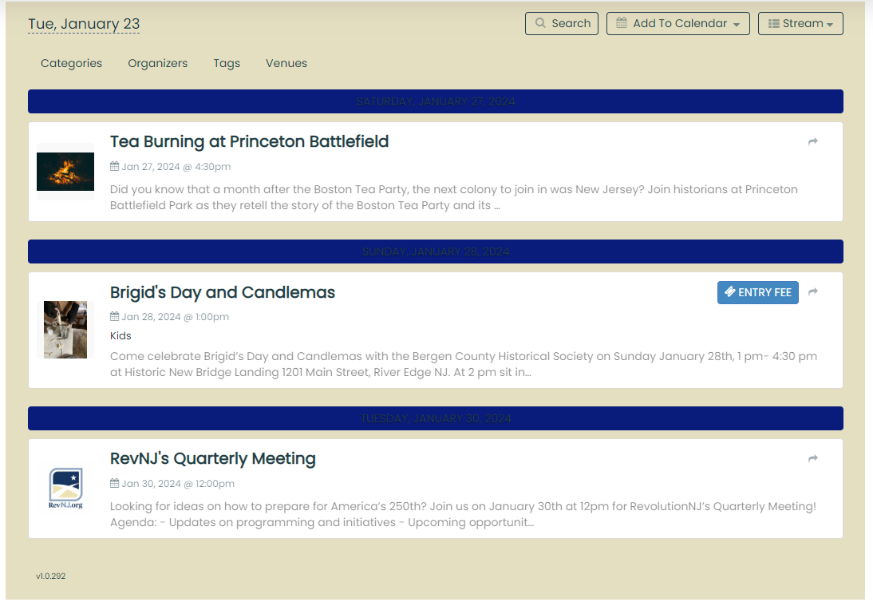
RevolutionNJ Event Calendar is Now Live!
https://www.revnj.org/calendar

Slide 10
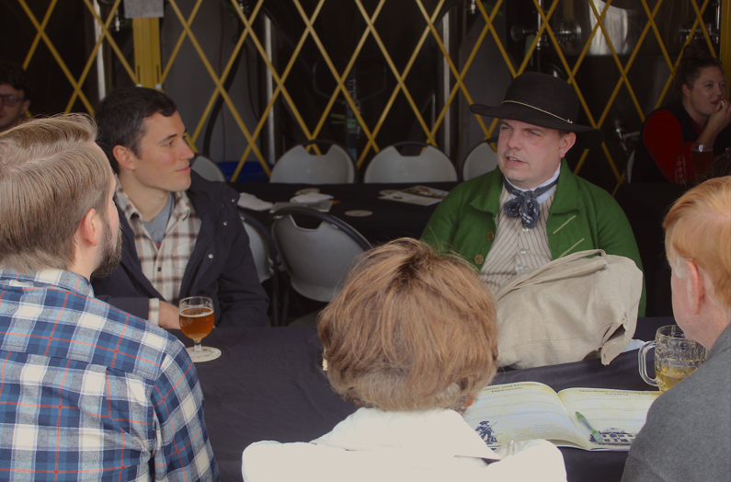
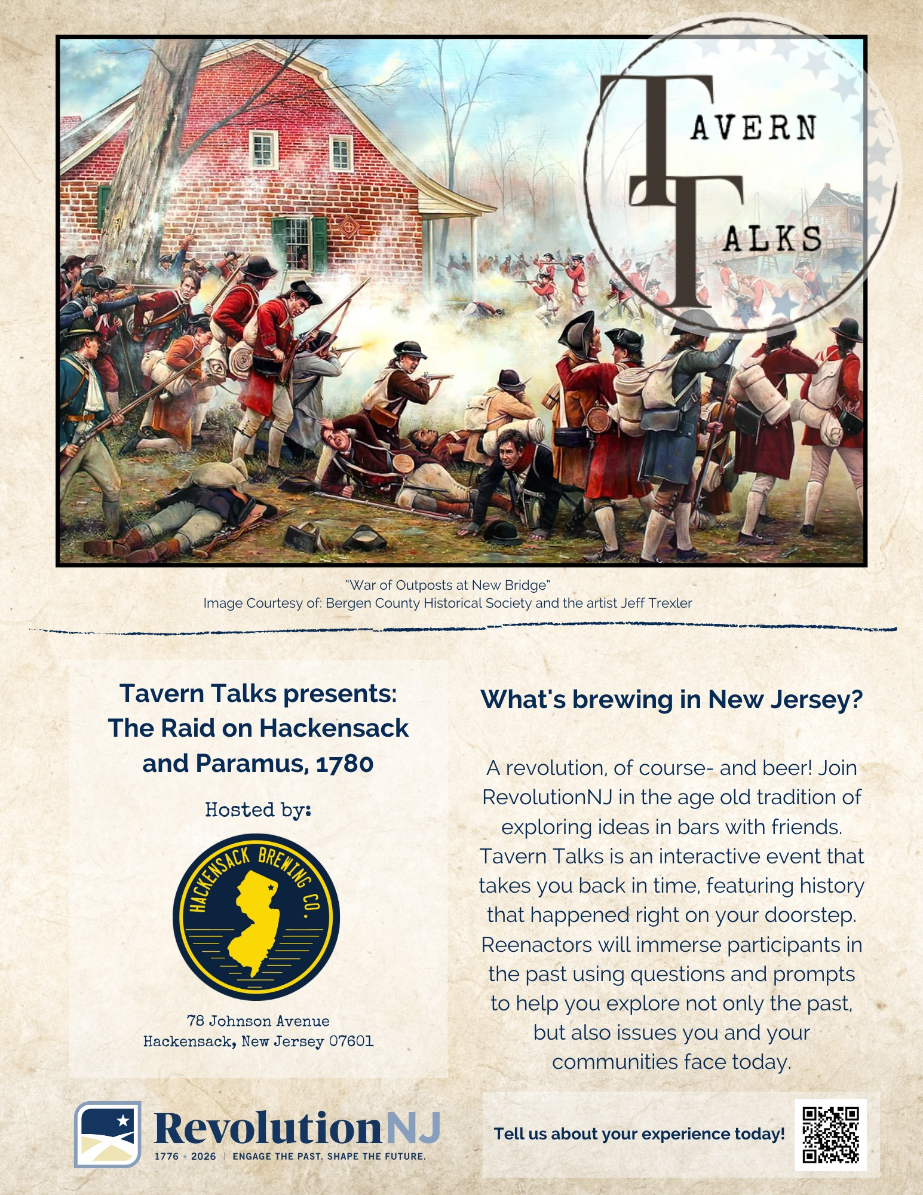
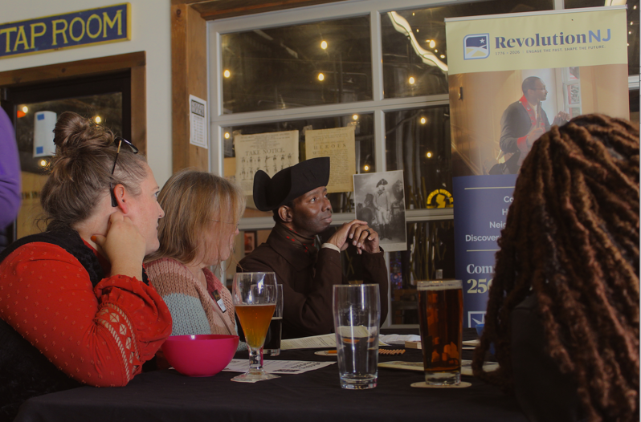
Tavern Talks
Our first Tavern Talks occurred at Hackensack Brewing.
Check out the booklet we created for the event here:
https://www.revnj.org/s/TAVERN-TALKS-HACKENSACK-BREWING.pdf
Keep an eye out for future Tavern Talk events and our new event request portal.

Slide 11
Indigenous Education Report
Indigenous Education Report is now available:
https://www.revnj.org/s/Final-New-Jersey-Indigenous-Education-Project-Plan.pdf
A recording of the webinar is available on the New Jersey Historical Commission YouTube page:
https://youtu.be/LTahm_vvqWU?si=lLT-jm7SfZLW1902

Slide 12
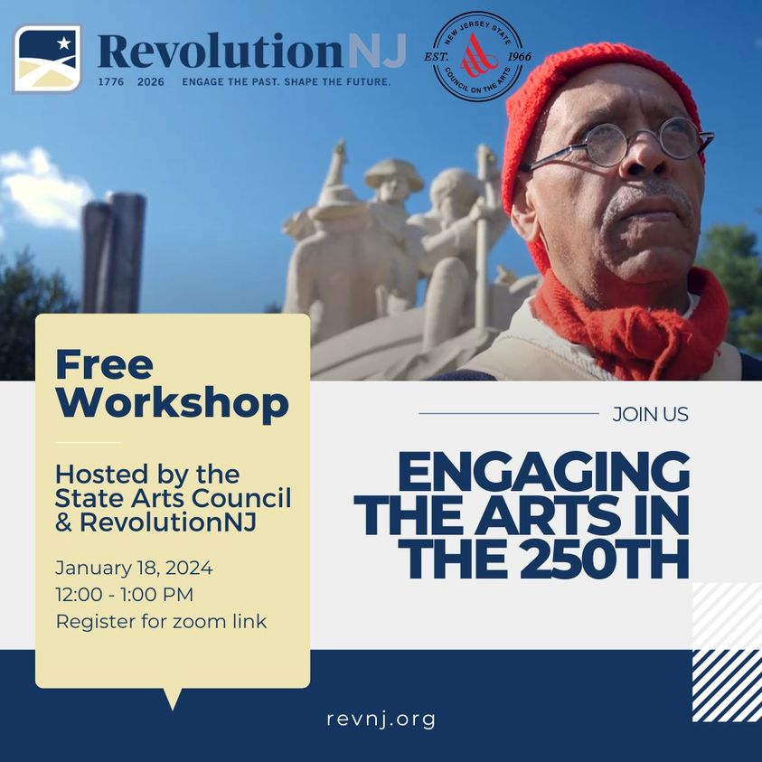
Arts Technical Assistance Webinar
Over 100 artists and arts organizations joined us to discuss the intersection between history and the arts for the 250th.
Webinar Recording:
https://youtu.be/21FCZHrp7Yk?si=epOO0iRN7g1mGgzE
Presentation Deck:
https://www.revnj.org/s/Arts-Technical-Assistance-Webinar-1_18_24.pptx

Slide 13
Public Arts Interest Survey
RevolutionNJ is seeking potential hosts for temporary art installations. Working closely with the New Jersey State Council on the Arts and the nationally renowned public art and research studio, Monument Lab, RevolutionNJ plans to install temporary public art pieces by New Jersey-based artists that demonstrate the complexity of history throughout the state.
To submit an application of interest, please visit: https://bit.ly/rnjpa
Deadline for public arts installation interest is Feb. 1, 2024.

Slide 14
Need Help? We Have Resources Available on www.revnj.org
Revnj.org/resources
Professional Development Webinars and Resource Lists
Big Ideas: Concepts for the 250th
A Bundle of Silences: Interpretive Approaches to the Past
Placemaking for the 250th: A Roadmap for RevolutionNJ
Suggested Readings
Strategic and Interpretive Frameworks
Handbook
News, Blogs, and Reports

Slide 15
Join the Revolution Today!
Is your municipality one of over 45 who have already joined us? If not, become a RevolutionNJ Community today!
Join over 65 organizations in becoming a RevolutionNJ Proud Partner
https://www.revnj.org/communities
https://www.revnj.org/revnjpartners

Slide 16
Around the Field

Slide 17
New Jersey Black Heritage Trail Now Accepting Site Nominations!
Any member of the public, public or private institution may make nominations to the Black Heritage Trail. Applicants are required to submit an online application that will include a historical narrative, a bibliography, site location, and documentation of the site. You can find the application on the NJHC website’s African American page www.history.nj.gov.
For individuals or organizations who are interested in learning more about the Black Heritage Trail and the nomination process, a recorded application video is now available on the NJHC YouTube channel at https://www.youtube.com/watch?v=I2A8KZNvoSM.
The NJHC will also provide a workshop on the application process on February 1st, at 6:30PM. To register for the live seminar, please visit https://bit.ly/BHT1. More information about these workshops can be found at www.history.nj.gov.

Slide 18
Virtual Workshop Opportunity
"Despite broad public support for a full and honest portrayal of American history, fundamental divisions persist. How can the history field navigate disputes about the past, build on areas of consensus, and make the most of the coming U.S. 250th anniversary? This virtual summit will explore research, strategies, and case studies to help history doers navigate today's fractious discourse. Learn more and register at:"
tinyurl.com/DoingHistorySummit

Slide 19
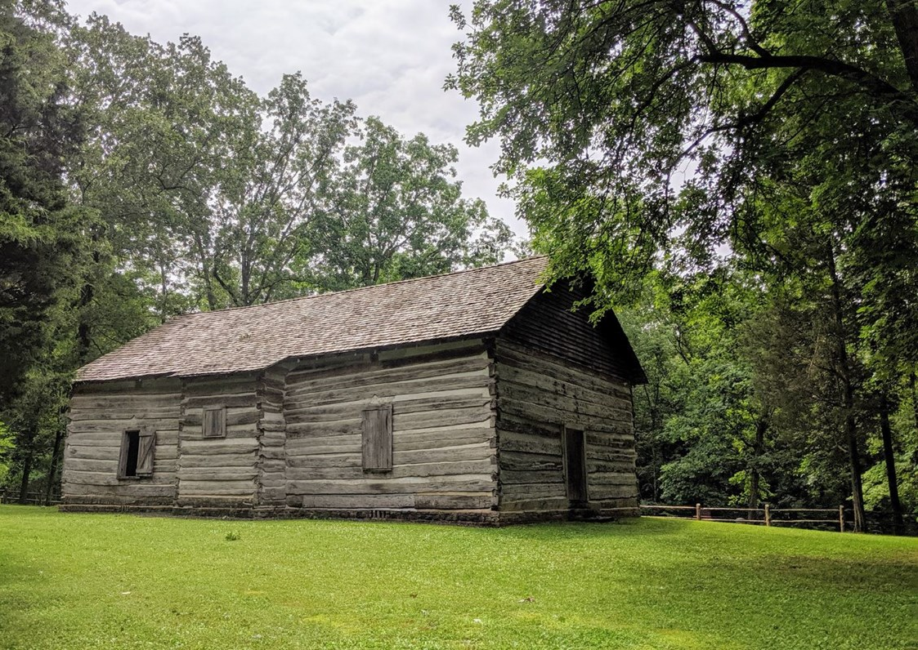
Grant Opportunity: NPS Semiquincentennial Grant Program
"Semiquincentennial Grant Opportunity from the National Park Service and America250. Congress has approved $10 million to preserve and restore sites and structures that commemorate the founding of the nation. A webinar was held on January 11, 2024, at 3:00 pm EST."

Slide 20
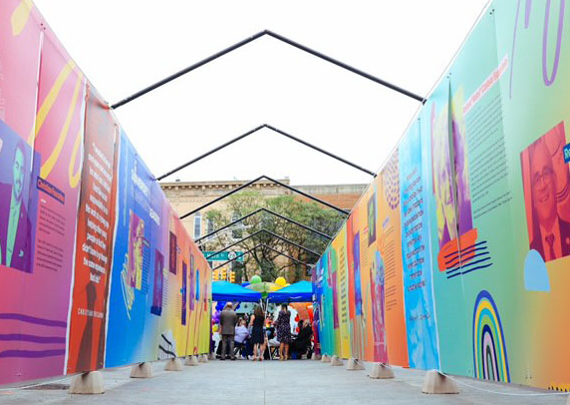
Grant Opportunity: NEA Grants for Arts Project
"The NEA is partnering with America250 to encourage arts projects that educate and engage communities in dialogue about the past, present, and future of our nation.
Project examples may include public art recognizing the milestone, collaborative community arts projects exploring the nation’s identity, or retrospectives of celebrated or overlooked American artists. Projects are welcome in all artistic disciplines."
Application Deadlines: February 15, 2024 and July 11, 2024, for projects taking place beginning in 2025.

Slide 21
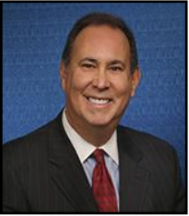
Guest Speaker
Jeff Vasser
(Executive Director of the New Jersey Division of Travel and Tourism)

Slide 22
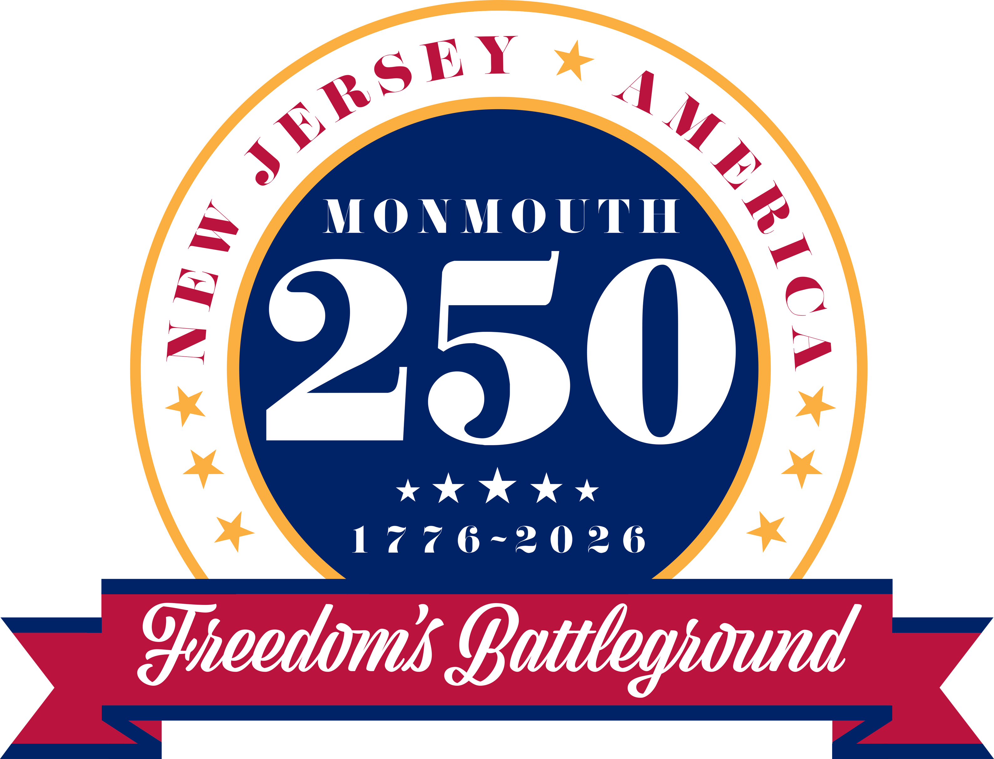
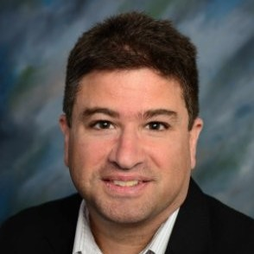
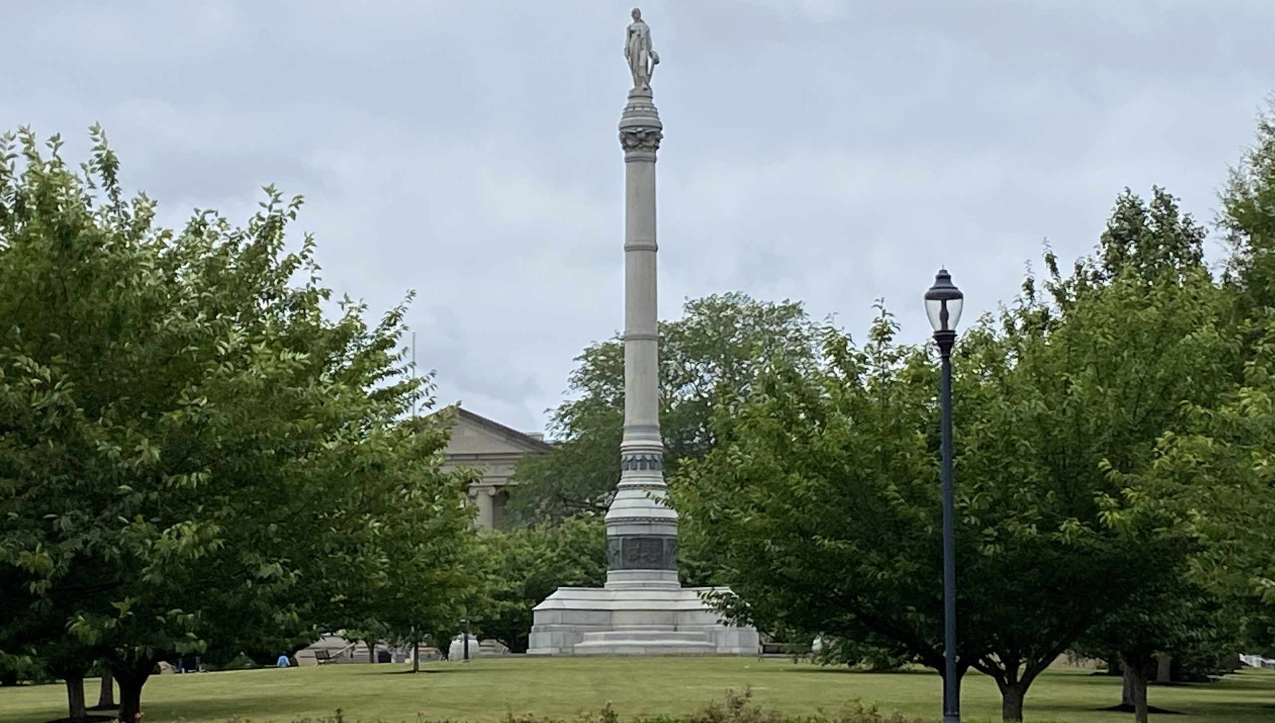
Guest Speaker
Ted Maturo
(Executive Director of Monmouth NJ 250)

Slide 23
Q&A

Slide 24
The 250th is Underway, Join In!
@revolutionnj
https://www.facebook.com/RevolutionNJ
www.revnj.org
Sara Cureton
New Jersey Historical Commission/ RevolutionNJ
Sara.Cureton@sos.nj.gov
Carrie Fellows
Crossroads of the American Revolution Inc./ RevolutionNJ
cfellows@revolutionarynj.org
Marc Lorenc
New Jersey Historical Commission/ RevolutionNJ
Marc.Lorenc@sos.nj.gov
24

