Slide 1
RevolutionNJ Quarterly Update
April 24, 2024
www.revnj.org

Slide 2
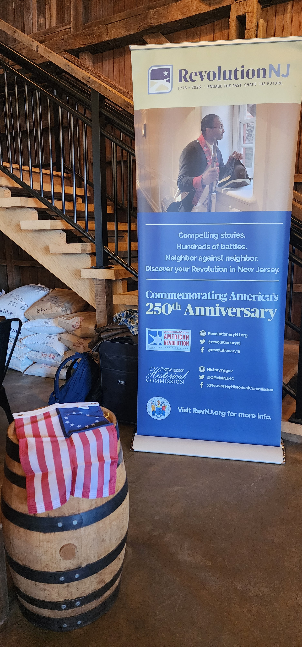
Today’s Agenda
In the News
Resources and Opportunities
Guest Speakers
RevolutionNJ Community: Somerset 250
RevolutionNJ Proud Partner: Homecoming 250
Q and A

Slide 3
In the News

Slide 4
Common Cause To All
Hosted by the VA250 Commission and the Colonial Williamsburg Foundation, the gathering provided a platform for attendees to participate in meaningful discussions about the upcoming 250th anniversary of the nation. The event was attended by representatives of 37 states.

Slide 5
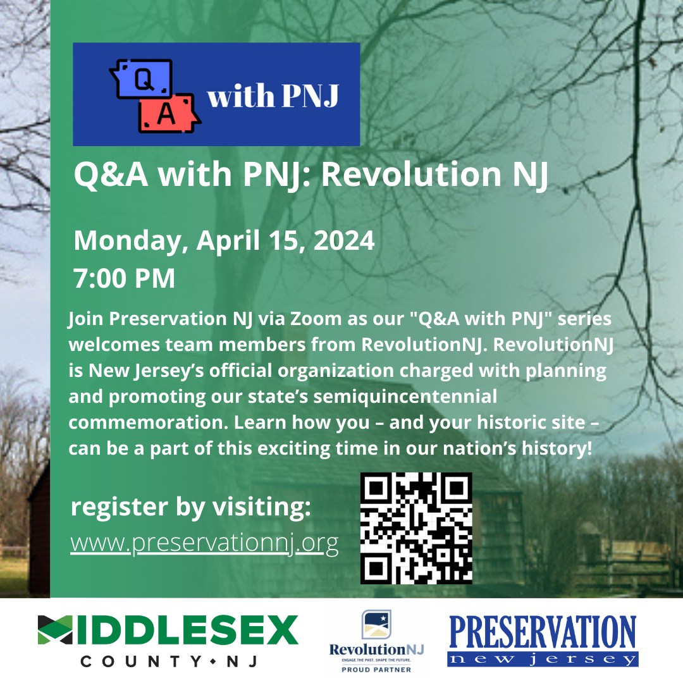
Webinars and Presentations
League of Historical Societies of New Jersey
Preservation New Jersey
Recordings available online at their respective organizations

Slide 6
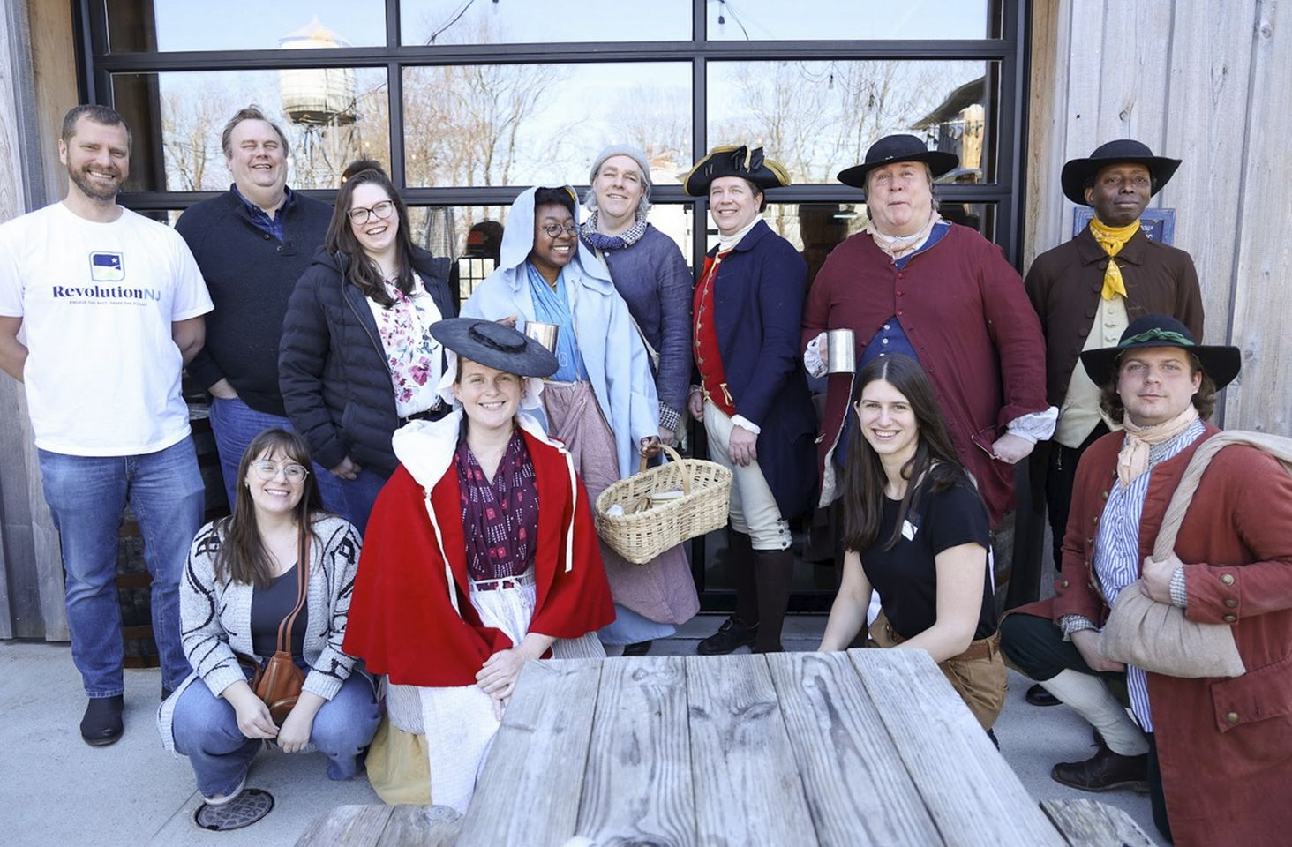
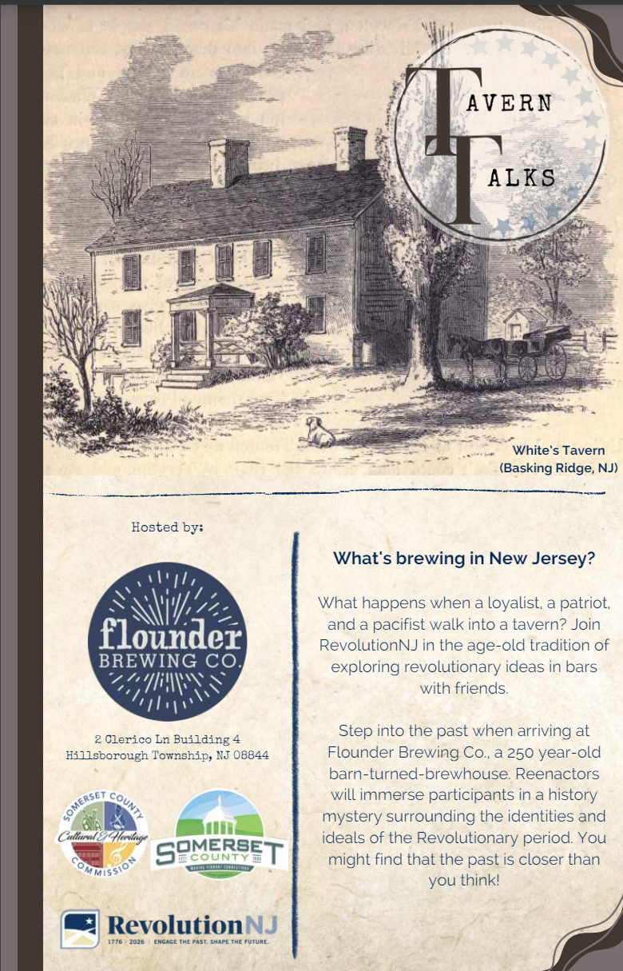
Tavern Talks
Held our 2nd Tavern Talks at Flounder Brewing Co in Hillsborough Township, Somerset County

Slide 7
Join the Revolution Today!
Is your municipality one of over 60 who have already joined us? If not, become a RevolutionNJ Community today!
Join over 100 organizations in becoming a RevolutionNJ Proud Partner
https://www.revnj.org/communities
https://www.revnj.org/revnjpartners

Slide 8
Resources and Opportunities

Slide 9
We are taking the Quarterly Meeting on the Road.
Vote for your favorite location in the Zoom poll. We will be hosting an in person Quarterly Meeting in July at the location with the most votes.

Slide 10
History Pinned
This year for Civic Season, RevolutionNJ will launch History Pinned!
Running from May 1st to July 31st, the History Pinned program will feature five sites from across the state that showcase the connection between history and civics. Participants who visit the sites will receive a unique button from each location. Those who collect all five buttons will be eligible for a special History Pinned prize.
2024 History Pinned Sites:
Alice Paul Institute
American Labor Museum
Hoboken Historical Museum
New Jersey State Museum
T. Thomas Fortune Cultural Center

Slide 11
Proud Partners Workshop
Keep an eye out for an announcement concerning an in-person workshop for our Proud Partners at the end of May 2024.
The workshop will be lead by RevolutionNJ staff and demonstrate how to do community-based participatory research, using the information gleaned to inform your 250th programming.
Space will be limited, with registration required.

Slide 12
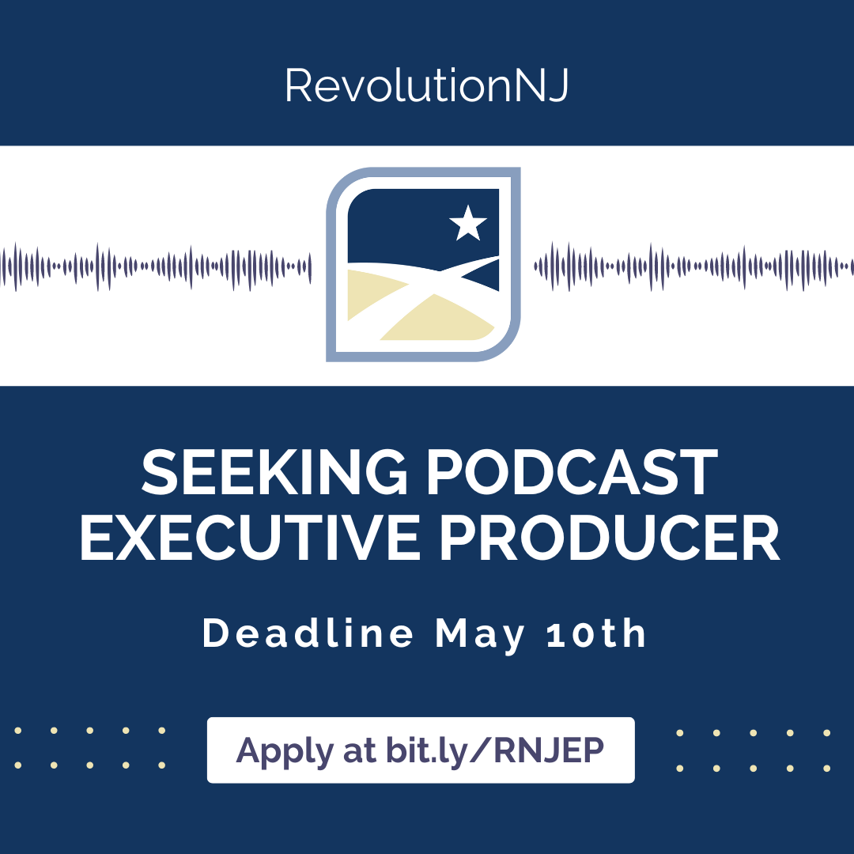

Slide 13
Need Help? We Have Resources Available on www.revnj.org
Revnj.org/resources
Professional Development Webinars and Resource Lists
Big Ideas: Concepts for the 250th
A Bundle of Silences: Interpretive Approaches to the Past
Placemaking for the 250th: A Roadmap for RevolutionNJ
Suggested Readings
Strategic and Interpretive Frameworks
Handbook
News, Blogs, and Reports

Slide 14
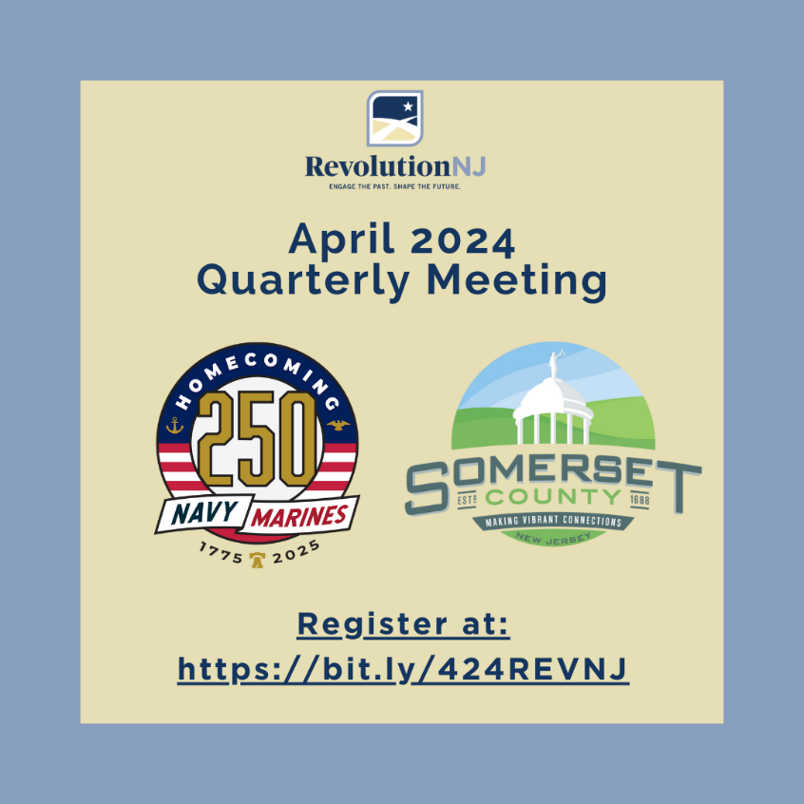
Submit Events to our Calendar!
Headline: as self-explanatory as possible.
Image: informational or dramatic, for Calendar and Social Media.
Short description: engaging and interesting, we can copy-edit it if necessary.
Details: host and participant organization(s), venue, date, time, cost.
LINK to details, sign up, payment, etc.
For Social Media: list of @ and # organizations.
Email to info@revnj.org

Slide 15
Guest Speakers

Slide 16
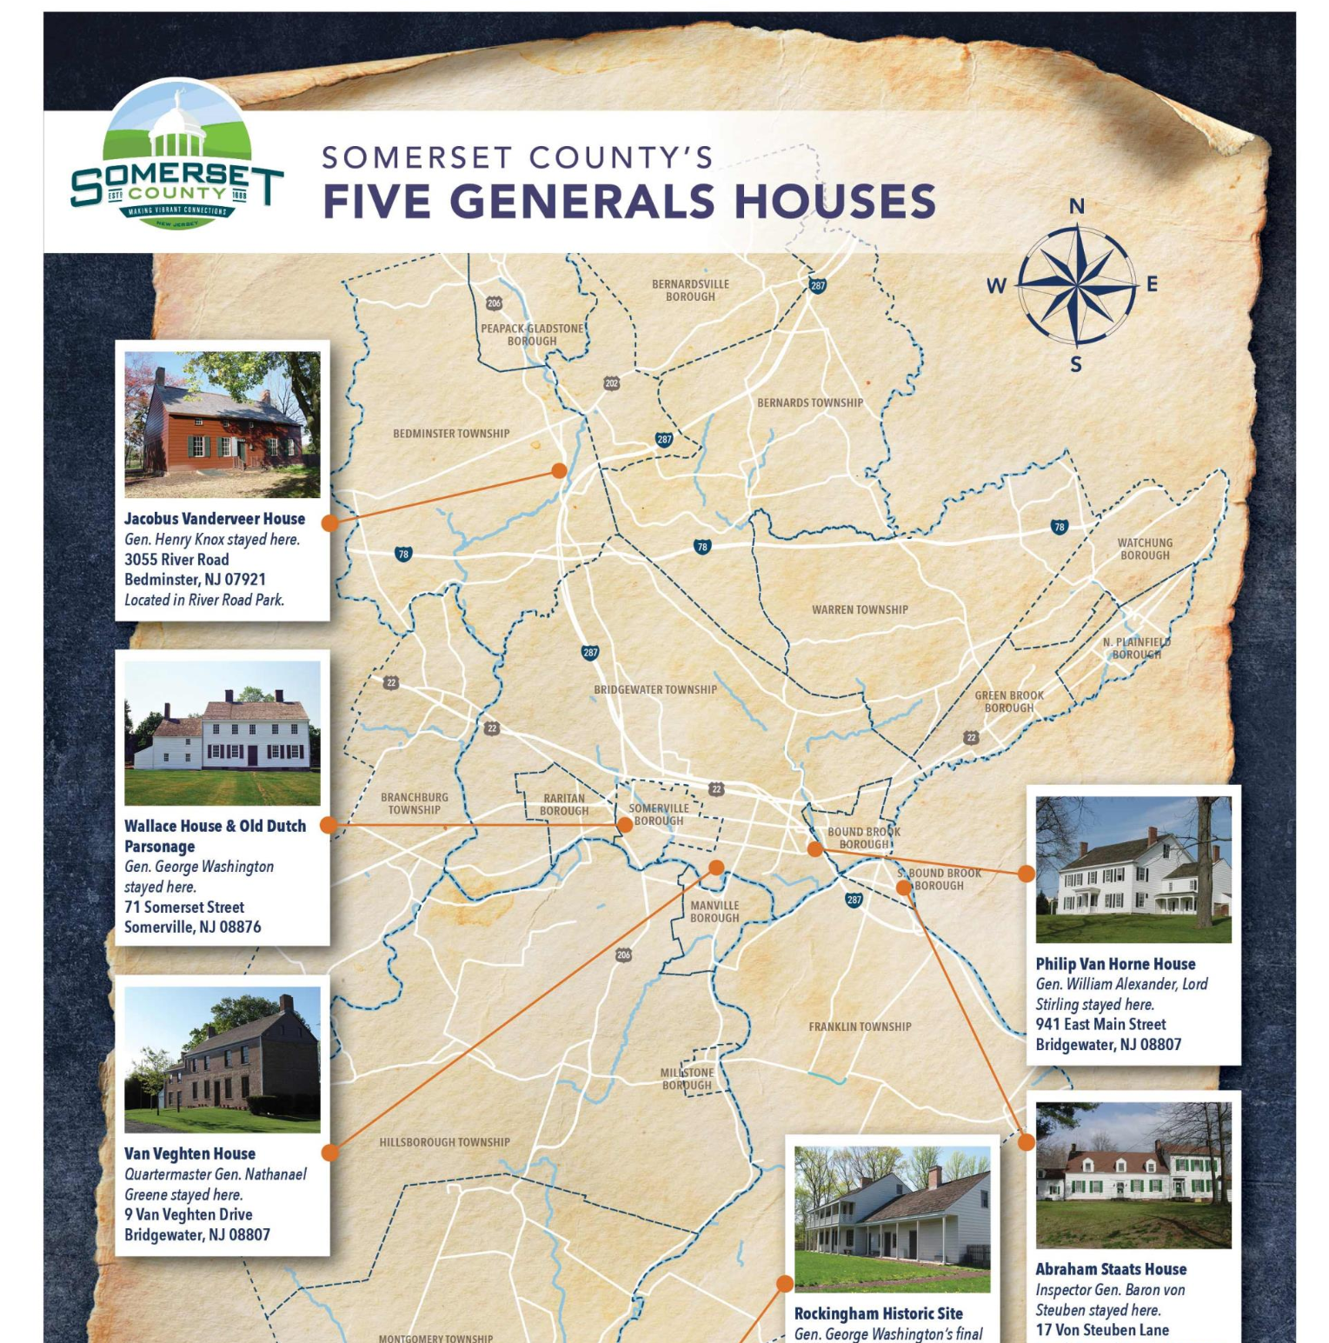
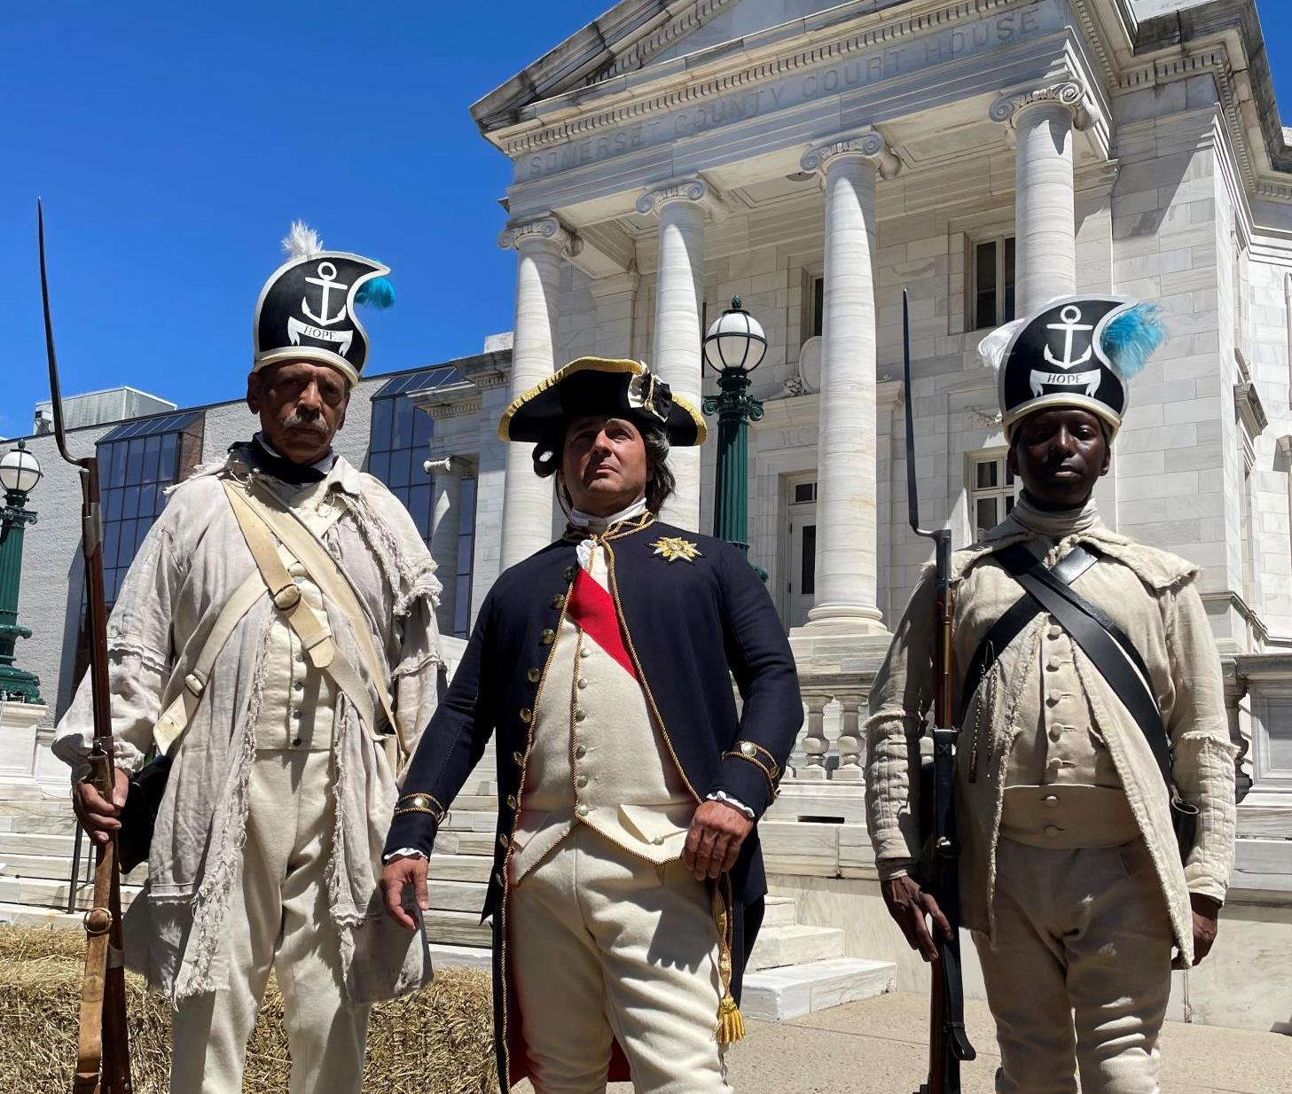
Guest Speaker: Somerset County 250
Colleen Mahr, Brad Fay, and Kaitlin Bundy
Somerset County 250

Slide 17
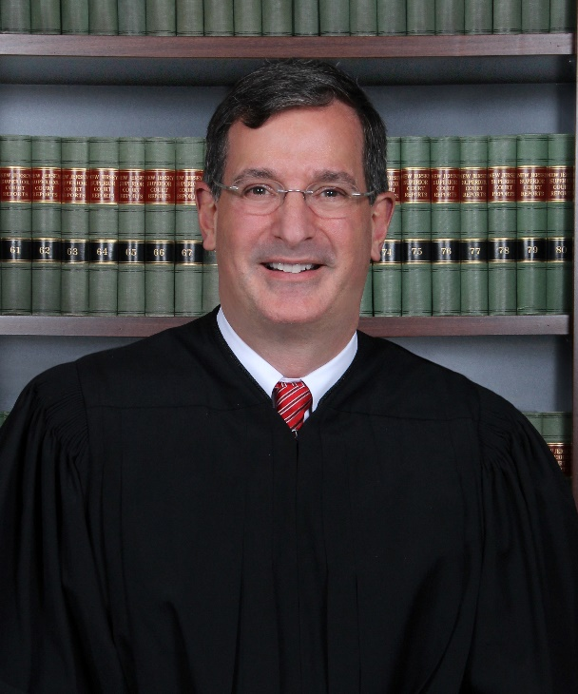
Guest Speaker: Homecoming 250
George Leone President and Chair of the Board of Homecoming 250 Navy Marine Corps

Slide 18
Q&A

Slide 19
The 250th is Underway, Join In!
@revolutionnj
https://www.facebook.com/RevolutionNJ
www.revnj.org
Sara Cureton
New Jersey Historical Commission/ RevolutionNJ
Sara.Cureton@sos.nj.gov
Carrie Fellows
Crossroads of the American Revolution Inc./ RevolutionNJ
cfellows@revolutionarynj.org
Marc Lorenc
New Jersey Historical Commission/ RevolutionNJ
Marc.Lorenc@sos.nj.gov

